Slide 1
Java Design Patterns
By Jagadish .S

Slide 2
What is a Design Pattern?
Design patterns represent the best practices used by experienced object-oriented software developers. It is a description or template for how to solve a problem that can be used in many different situations. These solutions were obtained by trial and error by numerous software developers over quite a substantial period of time.

Slide 3
Gang of Four (GOF)
In 1994, Design Patterns: Elements of Reusable Object-Oriented Software by Erich Gamma, Johnson, Richard Helm and John explained the usefulness of patterns and resulted in the widespread popularity of design patterns.
These four authors together are referred to as the Gang of Four (GoF).
In this book, the authors documented the 23 patterns they found in their respective works.

Slide 4
Usage of Design Pattern.
Common platform for developers
Design patterns provide a standard terminology and are specific to particular scenario. For example, a singleton design pattern signifies use of single object so all developers familiar with single design pattern will make use of single object and they can tell each other that program is following a singleton pattern.
Best Practices
Design patterns capture solutions which have been successfully applied to problems. By learning these patterns and the related problem, an unexperienced developer learns a lot about software design.

Slide 5
Types of Design Pattern
As per the design pattern reference book Design Patterns - Elements of Reusable Object-Oriented Software, there are 23 design patterns. These patterns can be classified in three categories. We'll also discuss another category of design patterns: J2EE design patterns.
A. Creational Patterns These design patterns provides way to create objects while hiding the creation logic, rather than instantiating objects directly using new operator. This gives program more flexibility in deciding which objects need to be created for a given use case.
B. Structural Patterns These design patterns concern class and object composition. Concept of inheritance is used to compose interfaces and define ways to compose objects to obtain new functionalities.
C. Behavioral Patterns These design patterns are specifically concerned with communication between objects.

Slide 6
Composition
Composition is a special case of aggregation. In a more specific manner, a restricted aggregation is called composition. When an object contains the other object, if the contained object cannot exist without the existence of container object, then it is called composition.
Example: A class contains students. A student cannot exist without a class. There exists composition between class and students.

Slide 7
Design Pattern Catalog
CREATIONAL PATTERNS
Factory Method
Abstract Factory
Builder
Prototype
Singleton
STRUCTURAL PATTERNS
Adapter
Bridge
Composite
Decorator
Façade
Flyweight
Proxy
BEHAVIORAL PATTERNS
Chain of Responsibility
Command
Interpreter
Iterator
Mediator
Memento
Observer
State
Strategy
Template Method
Visitor

Slide 8
Design Pattern Catalog
J2EE PATTERNS
MVC
Business Delegate
DAO
Composite Entity
Front Controller
Intercepting Filter
Service Locater
Transfer Object

Slide 9
1. Transfer Object Design Pattern.
The Transfer Object pattern is used when we want to pass data with multiple attributes in one shot from client to server. Transfer object is also known as Value Object. Transfer Object is a simple POJO class having getter/setter methods and is serializable so that it can be transferred over the network.
It does not have any behavior. Server Side business class normally fetches data from the database and fills the POJO and send it to the client or pass it by value.
For client, transfer object is read-only. Client can create its own transfer object and pass it to server to update values in database in one go.

Slide 10
Entities .
Following are the entities of this type of design pattern.
A. Business Object - Business Service which fills the Transfer Object with data.
B. Transfer Object -Simple POJO, having methods to set/get attributes only.
C. Client - Client either requests or sends the Transfer Object to Business Object.

Slide 11
Implementation.
We're going to create a StudentBO as Business Object, Student as Transfer Object representing our entities. TransferObjectPatternDemo, our demo class is acting as a client here and will use StudentBO and Student to demonstrate Transfer Object Design Pattern.

Slide 12
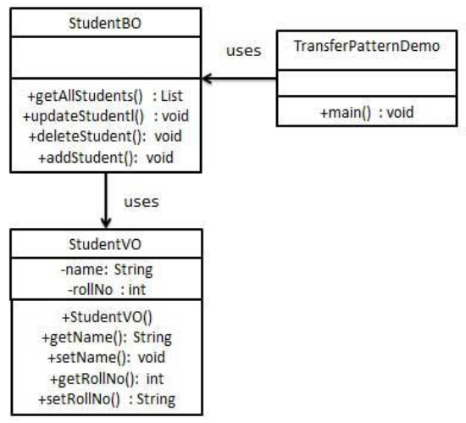
Class Diagram.

Slide 13
2. Single Ton Design Pattern
Singleton pattern is one of the simplest design patterns in Java. This type of design pattern comes under creational pattern as this pattern provides one of the best way to create an object. This pattern involves a single class which is responsible to creates own object while making sure that only single object get created. This class provides a way to access its only object which can be accessed directly without need to instantiate the object of the class.
Implementation
We're going to create a SingleObject class. SingleObject class have its constructor as private and have a static instance of itself. SingleObject class provides a static method to get its static instance to outside world.SingletonPatternDemo, our demo class will use SingleObject class to get a SingleObject object.

Slide 14
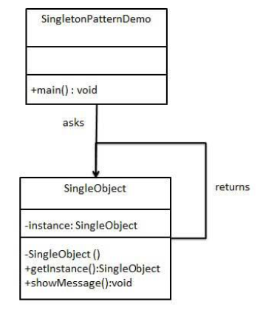
Class Diagram.

Slide 15
3. Adapter Design Pattern
Adapter pattern works as a bridge between two incompatible interfaces. This type of design pattern combines the capability of two independent interfaces. This pattern involves a single class which is responsible to join functionalities of independent or incompatible interfaces.
A real life example could be a case of card reader which acts as an adapter between memory card and a laptop. You plugins the memory card into card reader and card reader into the laptop so that memory card can be read via laptop.
We are demonstrating use of Adapter pattern via following example in which an audio player device can play mp3 files only and wants to use an advanced audio player capable of playing vlc and mp4 files.

Slide 16
Implementation.
We've an interface MediaPlayer interface and a concrete class AudioPlayer implementing theMediaPlayer interface. AudioPlayer can play mp3 format audio files by default. We're having another interface AdvancedMediaPlayer and concrete classes implementing theAdvancedMediaPlayer interface.These classes can play vlc and mp4 format files. We want to make AudioPlayer to play other formats as well. To attain this, we've created an adapter class MediaAdapter which implements the MediaPlayer interface and uses AdvancedMediaPlayerobjects to play the required format. AudioPlayer uses the adapter class MediaAdapter passing it the desired audio type without knowing the actual class which can play the desired format. AdapterPatternDemo, our demo class will useAudioPlayer class to play various formats.

Slide 17
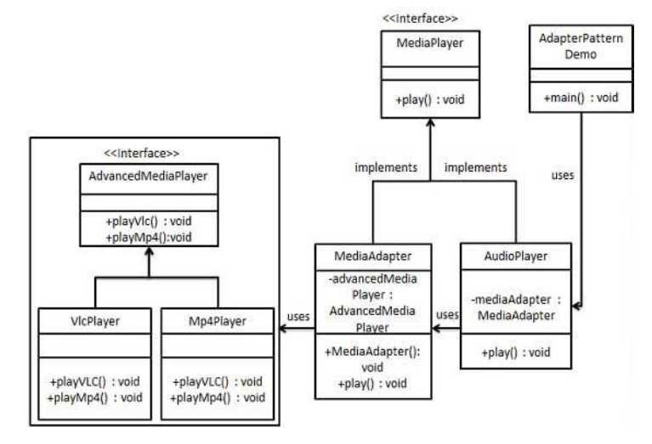
Class Diagram.

Slide 18
4. Filter Design Pattern
Filter pattern or Criteria pattern is a design pattern that enables developers to filter a set of objects, using different criteria, chaining them in a decoupled way through logical operations. This type of design pattern helps in combining multiple criteria to obtain single criteria.
Implementation
We're going to create a Person object, Criteria interface and concrete classes implementing this interface to filter list of Person objects. CriteriaPatternDemo, our demo class uses Criteria objects to filter List of Person objects based on various criteria and their combinations.

Slide 19
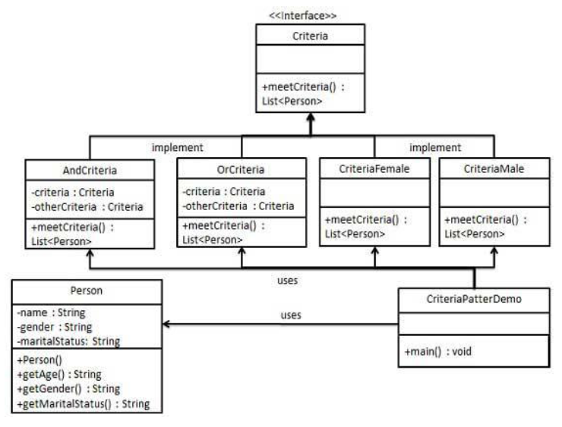
Class Diagram.

Slide 20
5. Builder Design Pattern
Builder pattern builds a complex object using simple objects and using a step by step approach. This type of design pattern comes under creational pattern as this pattern provides one of the best ways to create an object. A Builder class builds the final object step by step. This builder is independent of other objects.

Slide 21
Implementation.
We've considered a business case of fast-food restaurant where a typical meal could be a burger and a cold drink. Burger could be either a Veg Burger or Chicken Burger and will be packed by a wrapper. Cold drink could be either a coke or pepsi and will be packed in a bottle. We're going to create an Item interface representing food items such as burgers and cold drinks and concrete classes implementing the Item interface and a Packing interface representing packaging of food items and concrete classes implementing the Packing interface as burger would be packed in wrapper and cold drink would be packed as bottle. We then create a Meal class having ArrayList of Item and a MealBuilder to build different types of Mealobject by combining Item. BuilderPatternDemo, our demo class will use MealBuilder to build a Meal.

Slide 22
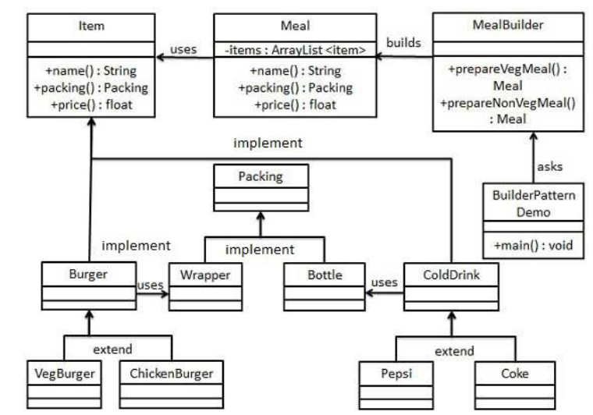
Class Diagram.

Slide 23
5. Front Controller Design Pattern
The front controller design pattern is used to provide a centralized request handling mechanism so that all requests will be handled by a single handler.
This handler can do the authentication/ authorization/ logging or tracking of request and then pass the requests to corresponding handlers.
Following are the entities of this type of design pattern.
A. Front Controller - Single handler for all kind of request coming to the application (either web based/ desktop based). B. Dispatcher - Front Controller may use a dispatcher object which can dispatch the request to corresponding specific handler.
C. View - Views are the object for which the requests are made.

Slide 24
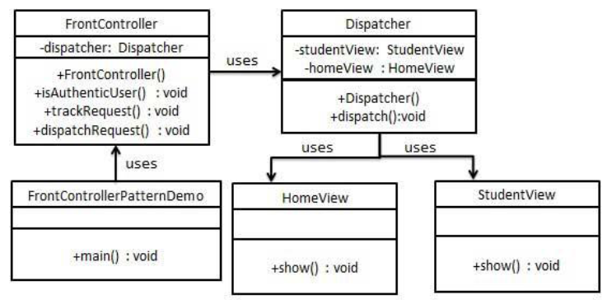
Implementation
We're going to create a Front Controller and Dispatcher correspondingly. HomeView and StudentView represent various views for which requests can come to front controller. FrontControllerPatternDemo, our demo class will use FrontController to demonstrate this Design Pattern.

Slide 25
Thank You
Write your feedback/Queries etc to jagadishs@enlume.com
EnLume Technologies

